Slide 1

COMMISSIONER FOR HUMAN RIGHTS
IN THE REPUBLIC OF KAZAKHSTAN
CONSTITUTION AND THE RULE OF LAW
IN CONTEMPORARY LEGAL SYSTEMS
Baku, 2025

Slide 2

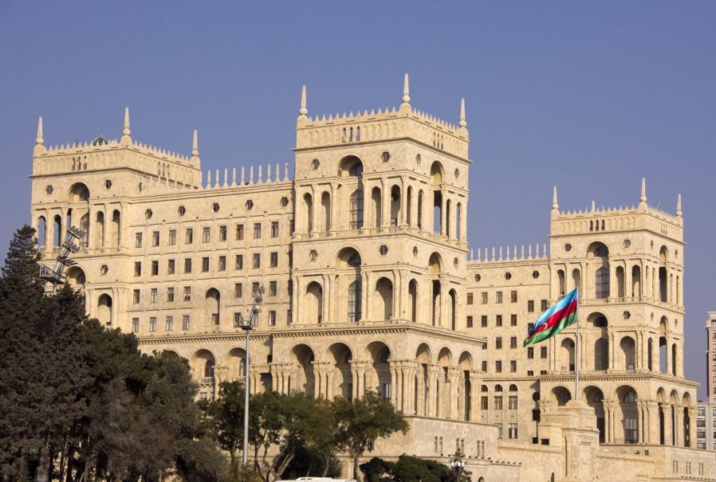

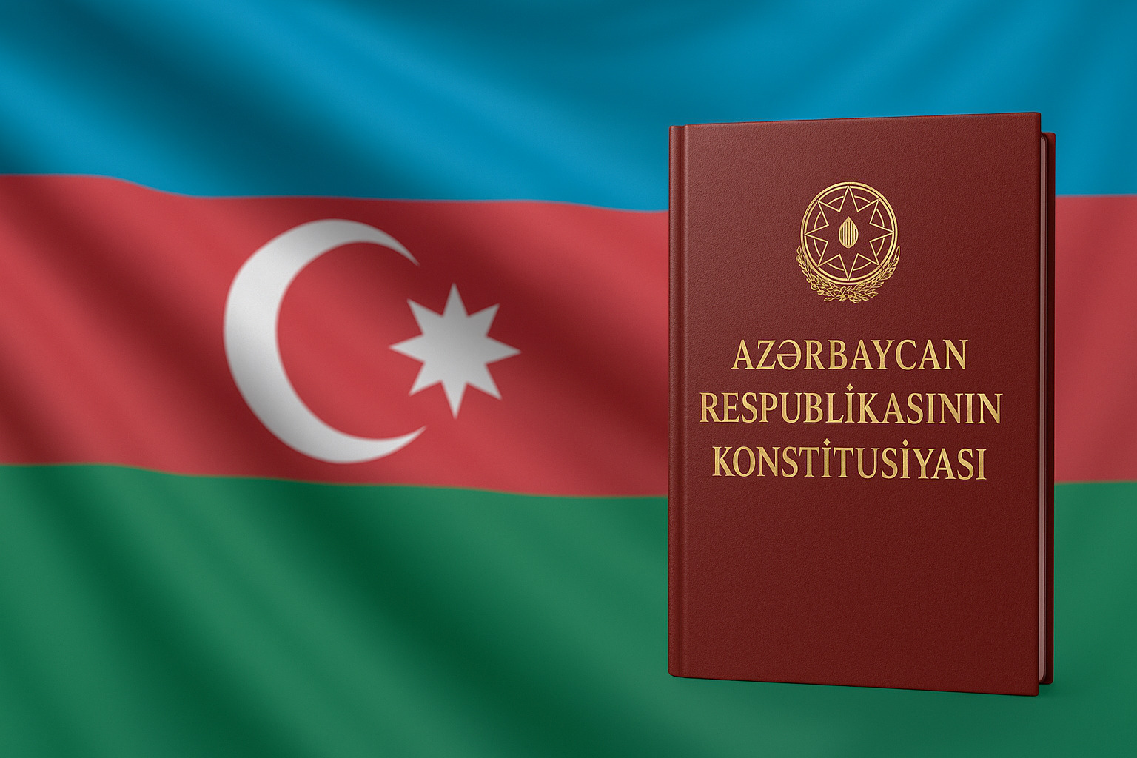
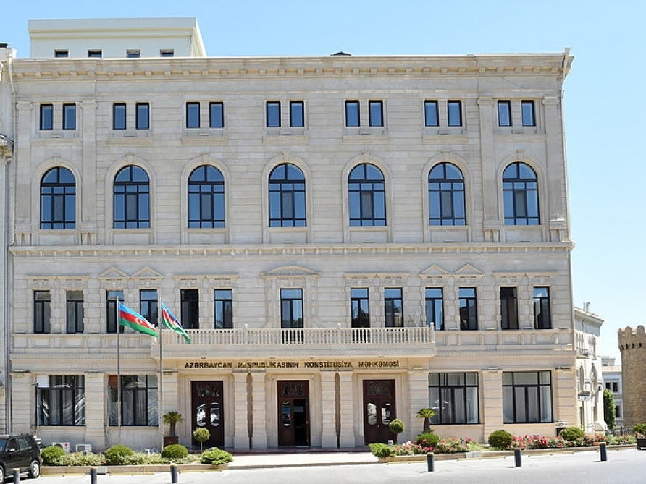
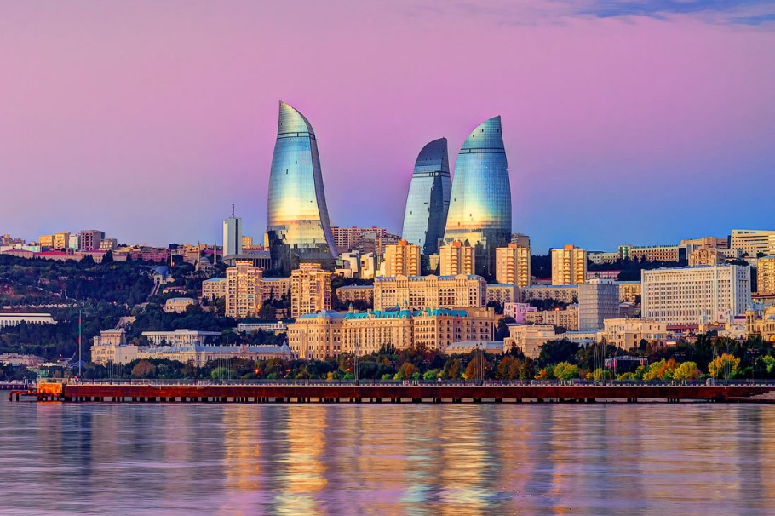
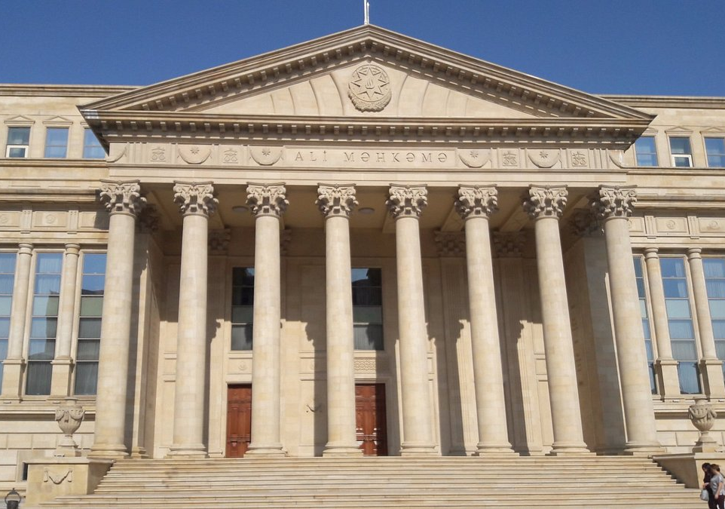
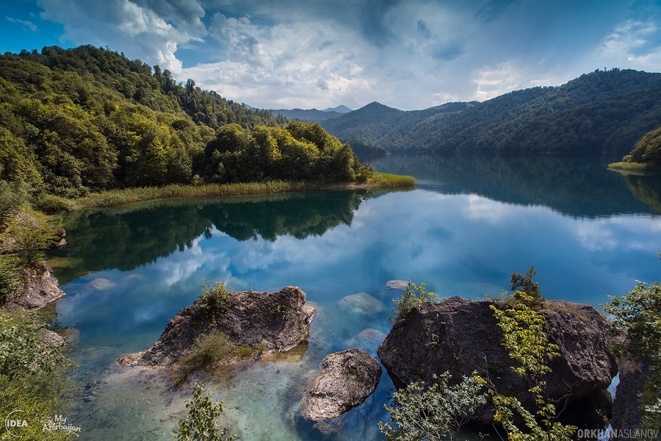
30th ANNIVERSARY OF THE CONSTITUTION OF AZERBAIJAN
2

Slide 3






NATURE OF THE FUNDAMENTAL LAW
CONSTITUTION
WILL OF THE PEOPLE
STABILITY
MATURITY
RULE OF LAW
DEVELOPMENT
3

Slide 4
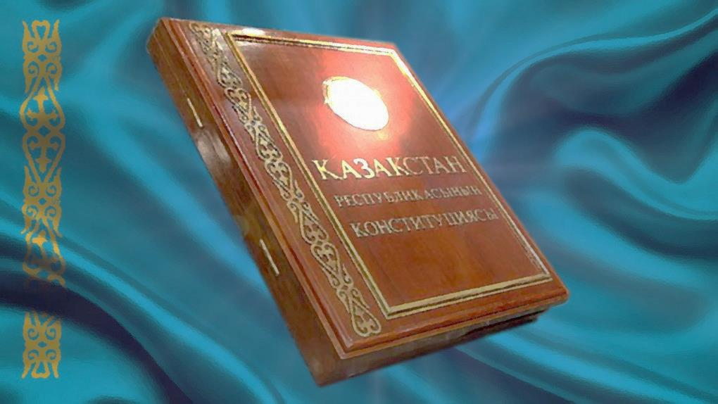

HISTORY
CONSTITUTION
OF THE REPUBLIC OF KAZAKHSTAN
AUGUST 30, 1995
STAGES OF DEVELOPMENT
1998
2007
2011
2017
2019
2022
4

Slide 5

CONSTITUTIONAL REFORM OF 2022
NATIONWIDE REFERENDUM
JUNE 5, 2022
PARTICIPATION OF 68% OF VOTERS
77% OF VOTES
IN FAVOR
5

Slide 6







SOURCE OF POWER – PEOPLE
“A STRONG PRESIDENT – AN INFLUENTIAL PARLIAMENT – AN ACCOUNTABLE GOVERNMENT”
DEVELOPMENT OF LOCAL
SELF-GOVERNMENT
SYSTEM OF GOVERNANCE REFORM
SUPER-PRESIDENTIAL
MODEL
EXPANSION OF POWERS
STRENGTHENING OF OVERSIGHT
ELECTION OF REGIONAL HEADS
PRESIDENTIAL–
PARLIAMENTARY
MODEL
6

Slide 7

HUMAN RIGHTS
COMMISSIONER
FOR HUMAN RIGHTS
CONSTITUTIONAL COURT
CONSTITUTIONAL STATUS
INDEPENDENCE
INSTITUTIONAL AUTHORITY
RIGHT TO PETITION
CITIZENS
PROSECUTOR GENERAL
OMBUDSMAN
7

Slide 8
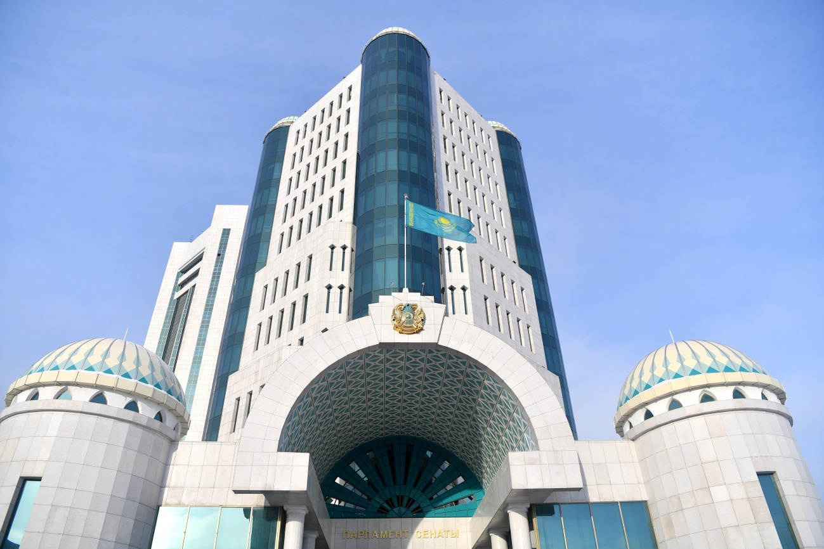
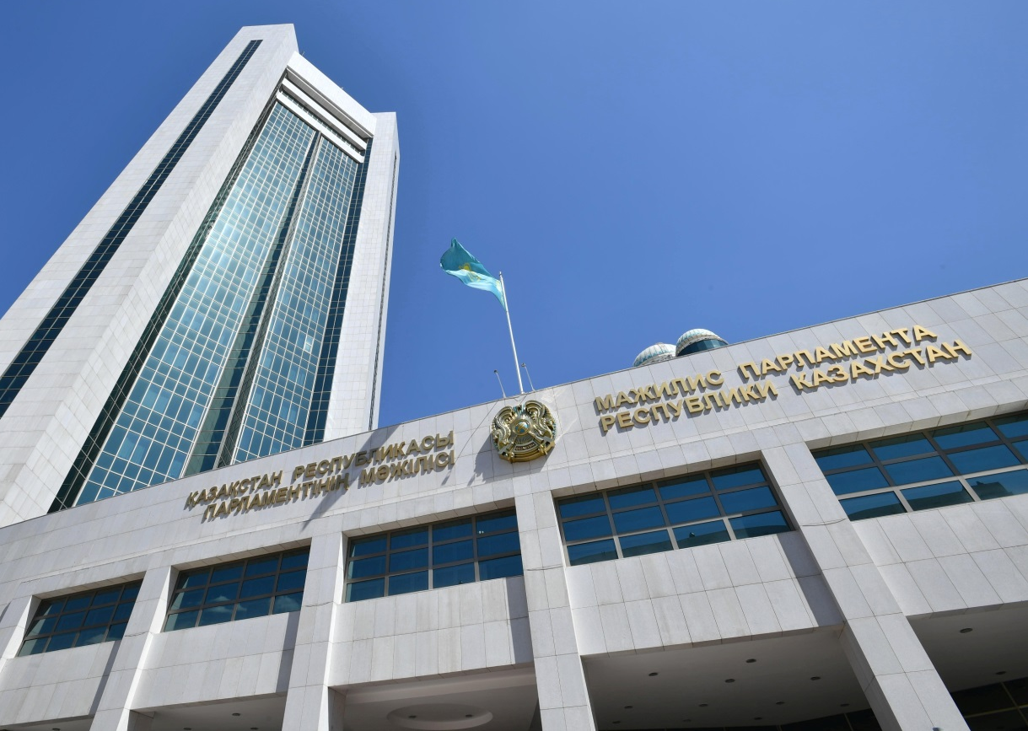

FUTURE PROSPECTS
SENATE
(UPPER HOUSE)
MAZHILIS
(LOWER HOUSE)
UNICAMERAL PARLIAMENT
8

Slide 9




DIGITAL TRANSFORMATION
OPPORTUNITIES
AND CHALLENGES
INDICATOR OF CONSTITUTIONAL GUARANTEES
PROTECTION OF HUMAN RIGHTS
9

Slide 10




Ombudspersonkazakhstan
Ombudsperson_kz
OmbudspersonKazakhstan

